Slide 1

Changing the Cryptographic Key That Secures the Web
Joshua Lai

Slide 2
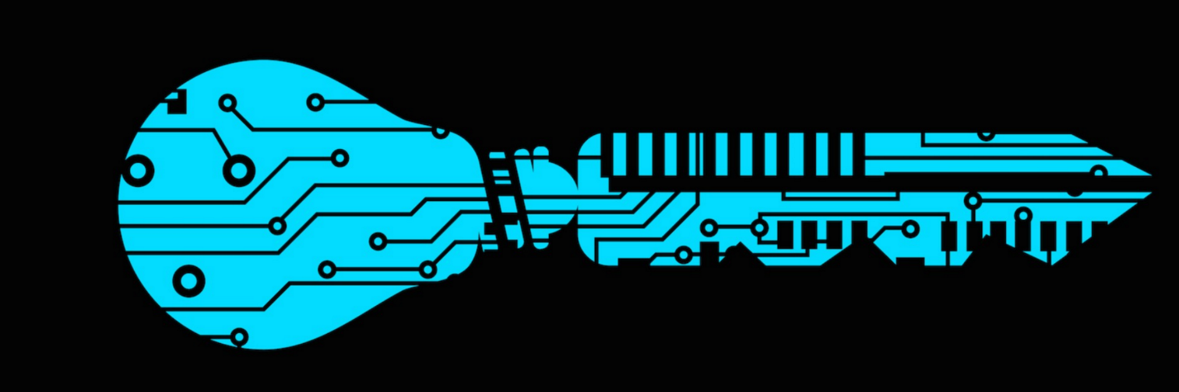
Wait? What Key?
How do we search for information on the web?
So how do we know that our searches are secure?

Slide 3

History
When the web was first released, the DNS was not configured with the ideas behind our security principles today.
Threats and Attacks on the DNS
So how do we protect the DNS in the first place?
The Internet Corporation for Assigned Names and Numbers (ICANN)

Slide 4
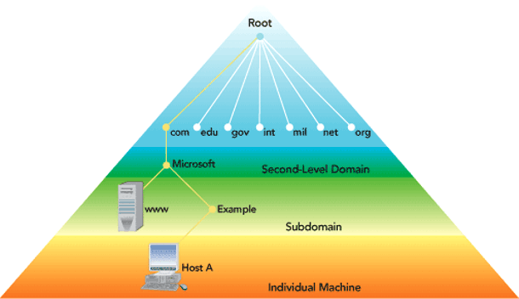
How does it work?
Key (part of DNS Security Extensions) creates the first link in a long chain of cryptographic trust and protects the DNS root zone
Processes and checks DNS data that comes in to ensure that it is correct
Any piece of incorrect data will return an error
If anyone holds this key, they can control much of the traffic
Note: Keys do not encrypt data

Slide 5
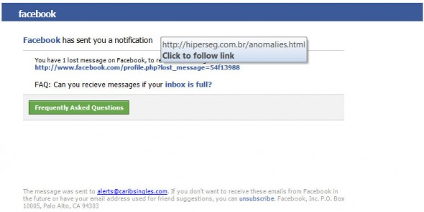
Why Change?
One of the biggest security issue is DNS cache poisoning / DNS spoofing
Forcing the DNS to return incorrect IP address and diverting traffic to different location
Good cryptographic hygiene like changing your personal passwords occasionally
Increase 1024 bits -> 2048 bits

Slide 6
So how does this apply to you?
Heightened protection for your sake when you are looking up documentation for this class
Continue browsing like you always do
Just be cautious of where you are going
Know that at anytime, the key can be compromised

Slide 7
Sources
Cox, Joseph. “The Cryptographic Key That Secures the Web Is Being Changed for the First Time.” MOTHERBOARD, www.motherboard.vice.com/read/the-encryption-key-that-secures-the-web-is-being-changed-for-the-first-time.

